Slide 1

CLI BASED CHAT TOOL
Submitted by:- AMAN KAUSHIK
University roll no.:- 2018662
BTECH(CSE)
SEC - C
MENTOR – Asst. prof. Yuvraj joshi

Slide 2
INTRODUCTION
The development of a chat application using socket programming in Python offers a reliable and efficient solution for real-time communication between multiple clients. This project aims to create a user-friendly chat application that allows users to connect to a central server and exchange messages with each other seamlessly. By utilizing socket programming and multithreading, the application ensures concurrent connections and synchronized communication.
In today's digital era, communication plays a vital role in various domains, including team collaboration, social networking, and online gaming. Traditional chat applications often rely on centralized servers to facilitate communication between clients. However, this project leverages socket programming to establish direct connections between clients and the server, enabling efficient data transmission and real-time updates.

Slide 3
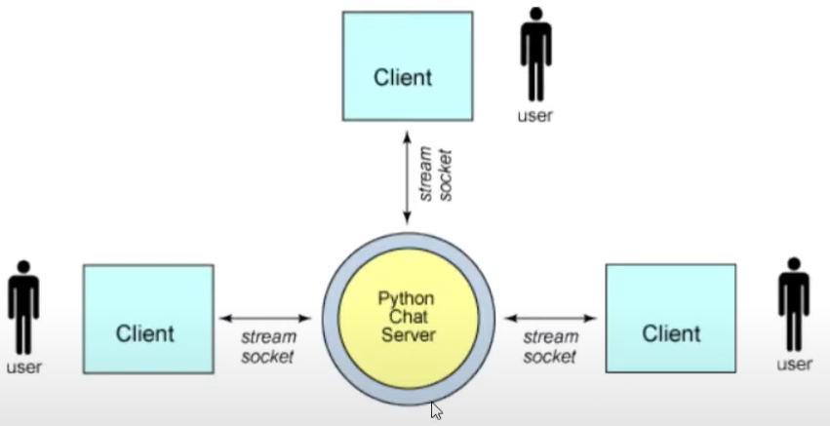
The primary objective of this project is to design and implement a chat application that addresses the need for instant and reliable communication. The client-side script allows users to input messages, which are then transmitted to the server. The server receives these messages and broadcasts them to all connected clients, excluding the original sender. Multithreading ensures that concurrent client connections are handled independently, ensuring smooth communication for all participants.

Slide 4
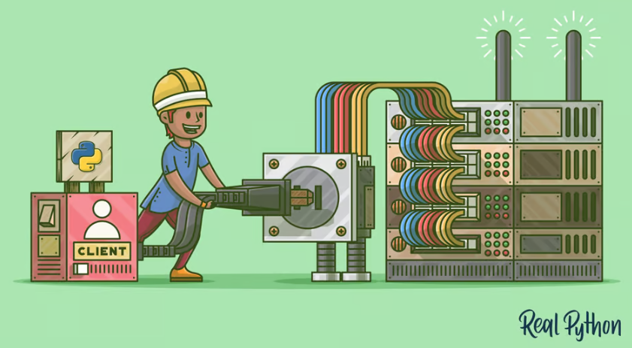
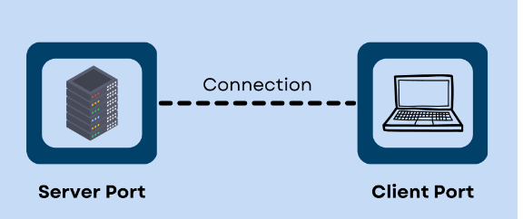
PROBLEM STATEMENT
The objective of this project is to design and implement a chat application that facilitates real-time communication between multiple clients using socket programming in Python. The application should allow clients to connect to a central server and exchange messages with each other. The server should be capable of handling concurrent connections from multiple clients, maintaining a list of connected clients, and broadcasting received messages to all clients except the sender. The application should provide a user-friendly interface, allowing clients to input messages and view the chat history. Additionally, the system should handle client disconnections gracefully, notifying other clients when a client joins or leaves the chat.

Slide 5
METHODOLOGY
The development of the chat application using socket programming in Python follows a systematic approach to ensure its successful implementation. The methodology includes the following key steps:
1. Requirement Analysis: Understand the specific requirements of the chat application, including the desired features, user interface, communication protocols, and client-server interaction. This step involves gathering user requirements and defining the scope of the project.
2. System Design: Based on the requirements, design the overall system architecture of the chat application. Identify the components, such as the client-side script and server-side script, and define their functionalities and interactions. Determine the data flow, message formats, and error handling mechanisms.
3. Implementation: Develop the client-side script and server-side script in Python, following the design specifications. Implement the socket programming logic to establish connections, send and receive messages, and handle concurrent client connections using multithreading. Ensure the scripts are well-structured, modular, and adhere to best coding practices.

Slide 6
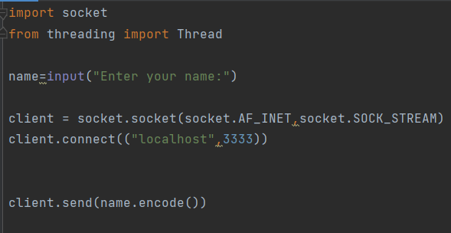
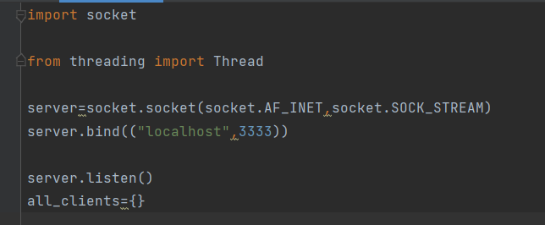
4. Testing: Conduct thorough testing of the chat application to ensure its functionality and reliability. Test various scenarios, such as multiple client connections, message transmission, handling of client disconnections, and error scenarios. Perform unit testing, integration testing, and system testing to identify and resolve any bugs or issues.
5. User Interface Design: Design a user-friendly interface for the client-side script. Create an interactive console-based interface that allows users to input messages, view the chat history, and receive notifications. Ensure the interface is intuitive, responsive, and easy to navigate.

Slide 7
6. Documentation: Prepare comprehensive documentation that includes the project overview, system architecture, installation instructions, usage guide, and any other relevant information. Document the design decisions, implementation details, and troubleshooting steps. This documentation will serve as a reference for future maintenance and enhancements.
7. Deployment: Deploy the chat application on a suitable server environment, ensuring that the server is accessible to the intended clients. Configure the necessary network settings and firewall rules to allow client connections to the server on the specified port. Provide instructions for clients to connect to the server and use the chat application.

Slide 8

. 8. Maintenance and Enhancements: Regularly monitor and maintain the chat application, addressing any issues or bugs that arise. Incorporate user feedback and make necessary enhancements or feature additions to improve the application's functionality and user experience.
By following this methodology, the chat application can be systematically developed, tested, and deployed, ensuring a robust and user-friendly communication platform for clients.

Slide 9
IMPLEMENTATION AND RESULTS:
The implementation of the chat application using socket programming in Python involves developing both the client-side and server-side scripts.
To run the chat application:
1. Save the client-side script as "client.py" and the server-side script as "server.py" in separate files.
2. Open two command prompt (terminal) windows.
3. In one window, navigate to the folder containing "server.py" and run the command `python server.py` to start the server.
4. In the other window, navigate to the folder containing "client.py" and run the command `python client.py` to start a client.
5. Repeat step 4 to start additional clients and establish connections with the server.
6. Enter a name for each client when prompted by the client-side script.
7. Clients can now send and receive messages through the chat application.
Note: Make sure the server is running before starting the clients. Additionally, ensure that the server is accessible to the clients (e.g., running on the same machine or accessible via the network). Adjust the host and port values in the code if needed.
This implementation provides a basic foundation for a chat application using socket programming in Python. Further enhancements, such as user interface improvements, message formatting, or additional features, can be added based on specific requirements.

Slide 10
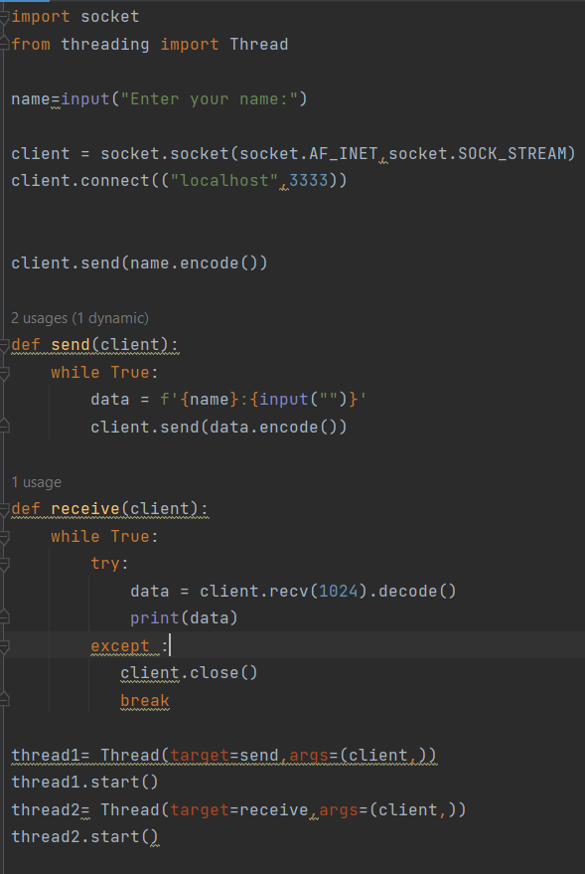
Client implementation-

Slide 11
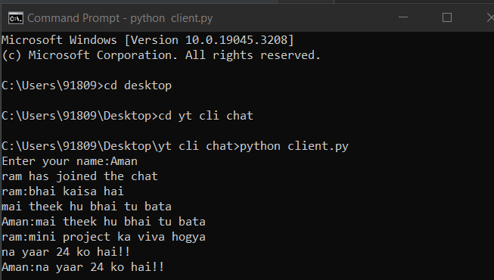
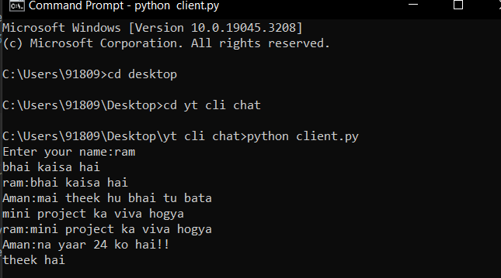
Result--

Slide 12
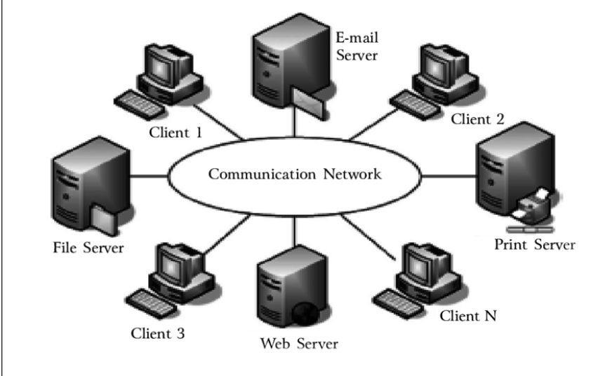
CONCLUSION
The chat application developed using socket programming in Python provides an efficient and reliable solution for real-time communication between multiple clients. The project successfully achieves its objective of creating a user-friendly chat platform that allows clients to connect to a central server and exchange messages seamlessly.

